Slide 1
Flight Delay Prediction
By
Aravind Krishnan R
Nitin Manoj

Slide 2
Introduction
Flight delays represent a formidable and multifaceted challenge within the aviation industry, wielding far-reaching consequences that ripple through the lives of passengers, the operational efficiency of airlines, the functionality of airports, and the overarching equilibrium of the entire air travel ecosystem. The repercussions of flight delays extend far beyond mere inconvenience, encompassing economic ramifications, safety concerns, and logistical intricacies that necessitate innovative solutions. It is within this intricate tapestry of challenges that the present study takes root, aiming to confront this complex issue head-on by introducing a sophisticated two-stage predictive machine learning model. The overarching objective of this research endeavor is unequivocal: to harness the power of cutting-edge technology and data-driven insights in order to provide airlines, airports, and passengers with precise and timely predictions of flight delays.

Slide 3
Motivation
The motivation behind embarking on this ambitious research journey is deeply rooted in the recognition of the pervasive and profound impact that flight delays wield on the aviation industry and its stakeholders.
Flight delays are far more than mere inconveniences; they are intricate challenges that demand innovative solutions.
The disruption they cause reverberates through the lives of passengers, affecting their schedules and well-being, while also burdening airlines with operational challenges and financial losses.
Airports grapple with logistical complexities, and the air travel ecosystem as a whole bears the weight of these delays.
It is this intricate web of consequences that has fueled our determination to leverage advanced machine learning techniques to provide accurate and timely predictions of flight delays.
By doing so, we aim to empower airlines, airports, and passengers with actionable insights, ultimately reshaping the landscape of air travel for the better.
Our research is driven by a vision of a future where the unpredictability of flight delays is tamed through data-driven precision, ushering in a new era of efficiency, safety, and convenience in aviation.

Slide 4
Scope Of the project
The scope of a flight delay prediction project encompasses a wide range of activities, from data collection and preprocessing to the development of machine learning models and their real-time deployment. This project aims to leverage historical flight data and weather information to provide accurate predictions of flight delays. The scope includes feature engineering, model selection, and evaluation to enhance predictive accuracy. Additionally, the project can extend its reach to real-time prediction, where live weather data and updated flight information play a pivotal role. Visualization and user-friendly interfaces may be developed to facilitate user interaction. Integration with airline and airport systems, as well as deployment in a production environment, are crucial considerations. The project can evolve to cover multiple airports, fostering collaboration with key stakeholders in the aviation industry. Continuous optimization, safety compliance, and potential business applications, along with contributions to research and innovation, further define the comprehensive scope of this endeavor

Slide 5
Predicting Delay Time
a sophisticated two-stage machine learning model designed to forecast flight delays is developed.
First stage, to classify whether the flight is delayed or not, multiple classification approaches are applied, including Logistic Regression, Decision Tree Classification, and Random Forest Classifier.
Delay for each flight delayed upon arrival is further predicted using regressor. The regressor is trained using the data of delayed flights. The features utilized for the training of classifiers are also used to train the regressors. The feature ArrDelayMinutes contains the arrival delay in minutes, and it is the target variable.
In Figure 1, There is a significant class imbalance, with more flights that are not delayed than ones that are delayed. This has an impact on the model's performance. This is due to a lack of information on the minority group in comparison to the dominant group.
This can be overcome by utilizing re-sampling techniques. Random Over Sampler is utilized to rectify the imbalance present in the dataset. The classification models were trained again after over sampling and their results were evaluated. The dataset after performing Random Over Sampling technique is illustrated in Figure 2.
a sophisticated two-stage machine learning model designed to forecast flight delays is developed.
First stage, to classify whether the flight is delayed or not, multiple classification approaches are applied, including Logistic Regression, Decision Tree Classification, and Random Forest Classifier.
Delay for each flight delayed upon arrival is further predicted using regressor. The regressor is trained using the data of delayed flights. The features utilized for the training of classifiers are also used to train the regressors. The feature ArrDelayMinutes contains the arrival delay in minutes, and it is the target variable.
In Figure 1, There is a significant class imbalance, with more flights that are not delayed than ones that are delayed. This has an impact on the model's performance. This is due to a lack of information on the minority group in comparison to the dominant group.
This can be overcome by utilizing re-sampling techniques. Random Over Sampler is utilized to rectify the imbalance present in the dataset. The classification models were trained again after over sampling and their results were evaluated. The dataset after performing Random Over Sampling technique is illustrated in Figure 2.

Slide 6
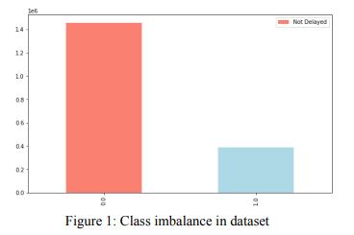
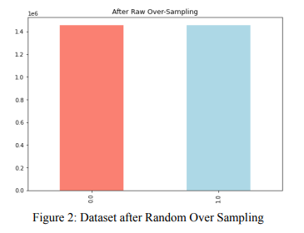

Slide 7
Literature Review
What variables factor into my departure or arrival time?
Airlines take many factors into consideration when determining the block time and your very specific departure and arrival times. The airport is a big component, including whether it’s a busy one like LaGuardia or Reagan National where there are a limited number of slots, or 30-minute to one-hour windows for a specific amount of flights a given airline is allowed to schedule. The airport infrastructure is also important, including how many gates are available and at what times, the busiest time of day for that particular location, how many runways are open, and whether construction or other constraints limit the number of flights or lengthen the block time. Airlines also take connections into account, backing out from the time that important connecting flights depart to determine when flights coming in should arrive. There is no hard and fast rule, but airlines factor in approximate travel time for passengers to deplane and walk to their connecting gates.
Additional factors that determine your flight schedule include the turn time, or the amount of time it takes the plane to empty out and the crew to clean and board the next flight, as well as whether there are crews that need to be swapped out who might be flying in from another destination.
Source : https://www.cntraveler.com/story/the-complex-process-behind-your-flights-schedule

Slide 8
Flight schedules are mapped out several months in advance by the schedule planning teams at the airlines, like Soren's, so factors like bad weather, runway construction, or other unexpected events will affect departure and arrival times. Most airlines have a different set of employees on the schedule planning team, or else look to the flight dispatchers, who sit in the system operations center and tweak schedules closer in, to accommodate real-time changes as the need arises.

Slide 9
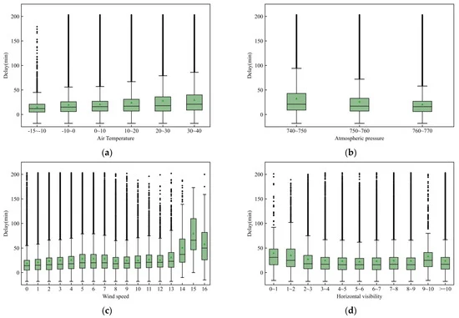
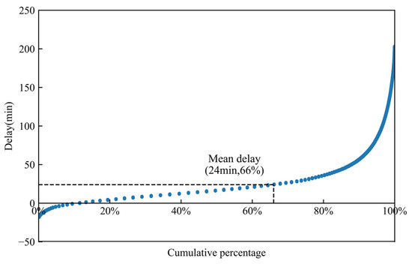
Author | Title | Year
X. Kong, Y. Cui, Q. Zhu, X. Jin, and X. Jin | Flight Delay Prediction: A New Ensemble Model Approach | 2012
This paper presents an ensemble model for flight delay prediction. The authors use a combination of random forests and support vector machines to predict delays. They also propose a feature engineering technique that incorporates historical weather data and airline-specific information. The paper compares their ensemble model to other methods and demonstrates its effectiveness in improving prediction accuracy.

Slide 10
Author | Title | Journal/year
ABHISHEK GUPTA | Flight Delay_Exploratory Data Analysis | 2023
In this project , Exploratory Data Analysis (EDA) on a comprehensive dataset of flight information, with a primary focus on understanding flight delay patterns. By analyzing this data, we aim to uncover insights into the factors that contribute to flight delays, the distribution of delays across different airlines and airports, and the temporal and geographical trends that might influence delay occurrences.
The author is able to predict the delay of flights in different airport and is able to plot a graph on what are the different factors affecting the delays.
He is able to rank which airport and airline has the most number of flight delays.

Slide 11
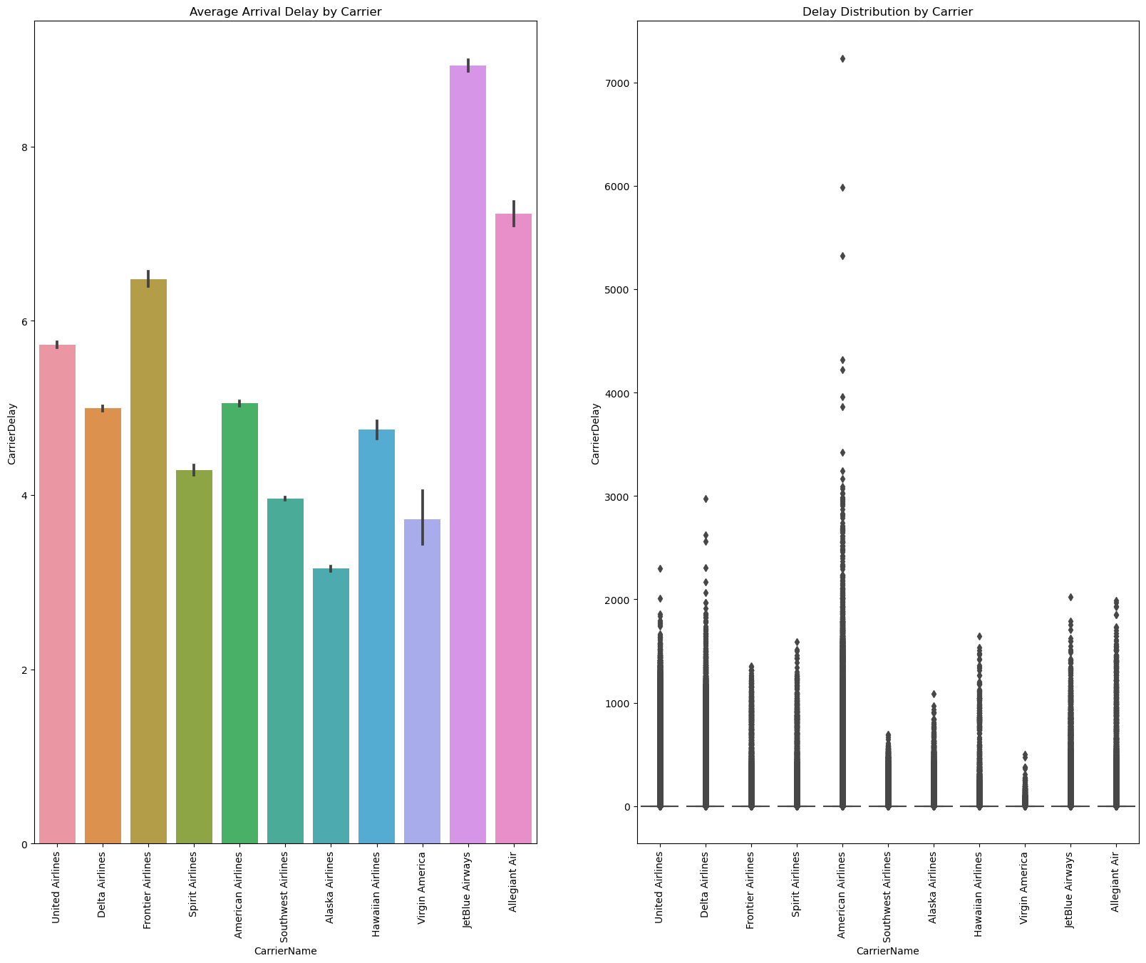
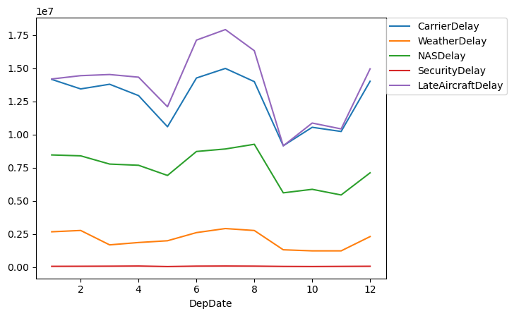

Slide 12
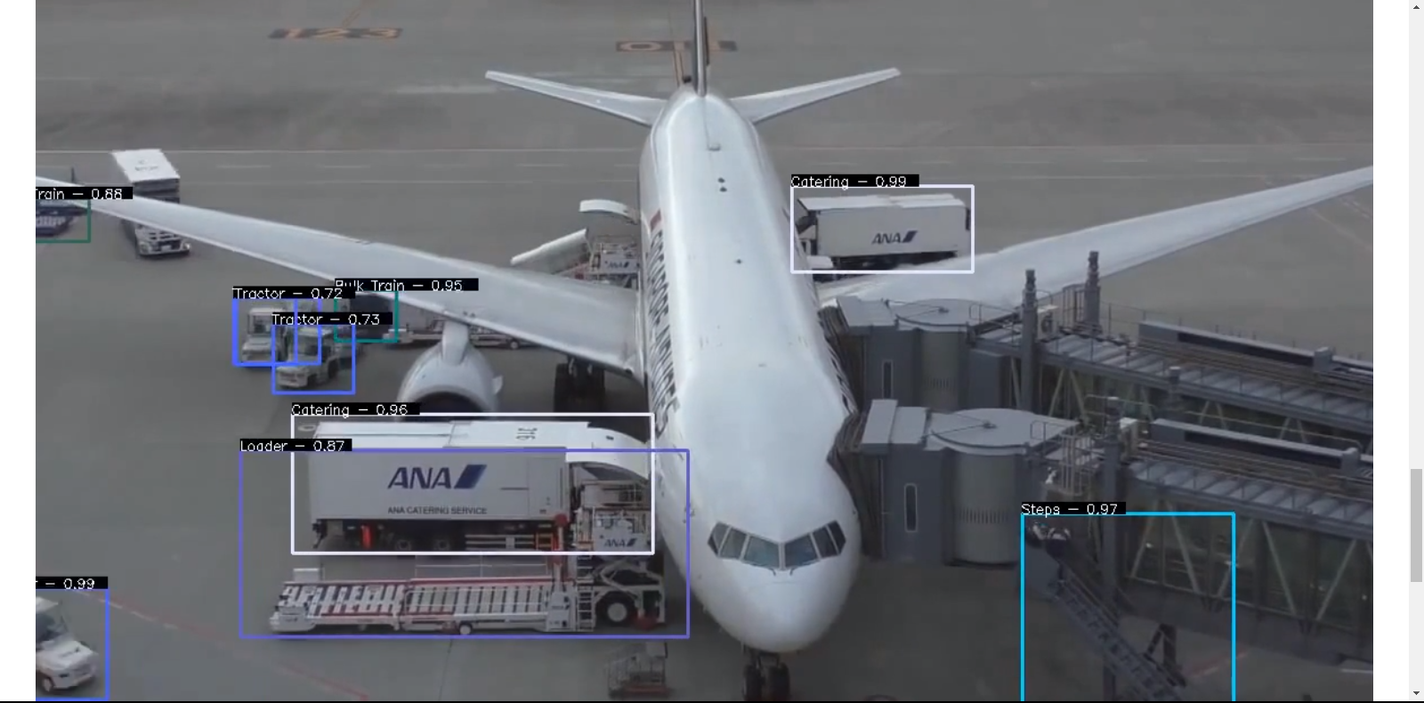
Future of the project
We can build a computer vision model which can detect and monitor different working happening in the ground level for the flight to take off on time.
Use historical data analysis on ground level to maximize efficiency in the airport.
Helps in accurate billing of air travel tickets.

Slide 13
References
Flight Delay_Exploratory Data Analysis by Abhisek Gupta : https://www.kaggle.com/code/argxgd/flight-delay-exploratory-data-analysis/notebook
https://www.cntraveler.com/story/the-complex-process-behind-your-flights-schedule
https://www.intell-act.com/
Belobaba, P. P. (1989). "Applications of advanced technology in airline operations." Transportation Science, 23(4), 239-251.
Clees, T. J., Voskanyan, A., & Johnson, E. L. (2017). "Predictive modeling of domestic flight delays." Computers & Operations Research, 78, 533-548.
Cui, X., Li, H., Kong, X., & Lee, H. W. (2014). "A data mining framework for the analysis of operational performance in the air transportation industry." Expert Systems with Applications, 41(8), 3813-3824.
Lu, C. T., Tsai, C. F., & Shih, H. Y. (2009). "Applying data mining techniques to explore the factors contributing to flight delays." Journal of Air Transport Management, 15(5), 274-279.
Odoni, A. R., Barnhart, C., & Barnhart, M. (2004). "An overview of airline scheduling." Transportation Science, 38(1), 2-13.
Rani, A. M., & Anwar, I. (2016). "Predicting flight delays using data mining techniques." Procedia Computer Science, 84, 132-139.
Xiao, F., Zou, B., Yang, L., & Wu, Y. J. (2013). "A hybrid model for aircraft departure delay prediction." Journal of Air Transport Management, 33, 78-86.

